Slide 1



TOPIC: Concrete compressive strength
Bhavan's Vivekananda College of Science, Humanities & Commerce
TEAM MEMBERS
MOUNIKA KURUKUNTLA
SAI TEJASRI DAGGUPATI
DESHIK DATTA MANKALA
KADIRI PRATHUSHA
SANJANA GOUD
SREE VANI

Slide 2
OBJECTIVE
Dataset is having eight inputs and one output column.. We have to predict the Concrete compressive strength taking the remaining eight attributes as input.

Slide 3

Data and Data Quality Check
Cement Blast Furnace Slag Fly Ash Water
Superplasticizer Coarse Aggregate Fine Aggregate Age
strength
Number of instances 1030 Number of Attributes 9 Attribute breakdown 8 quantitative input variables, and 1 quantitative output variable Missing Attribute Values None

Slide 4
UNIVARIATE ANALYSIS

Slide 5
UNIVARIATE ANALYSIS

Slide 6
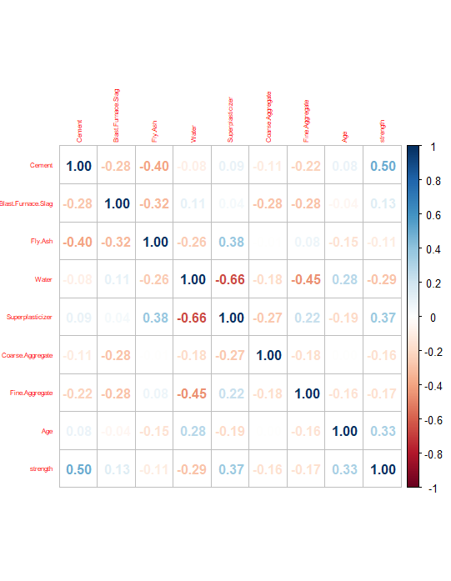
Correlation plot

Slide 7
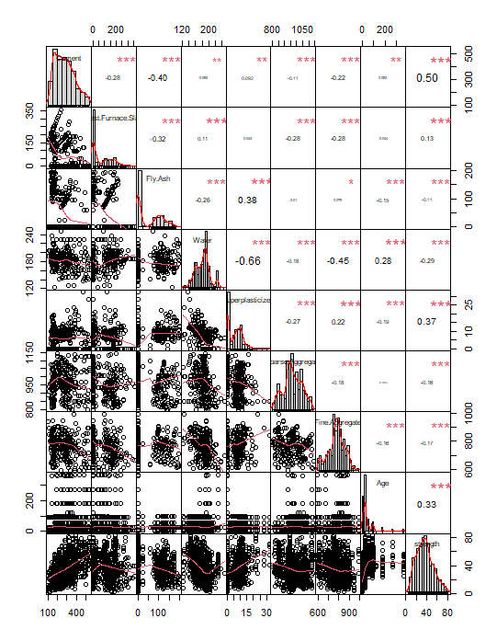
Correlation chart

Slide 8
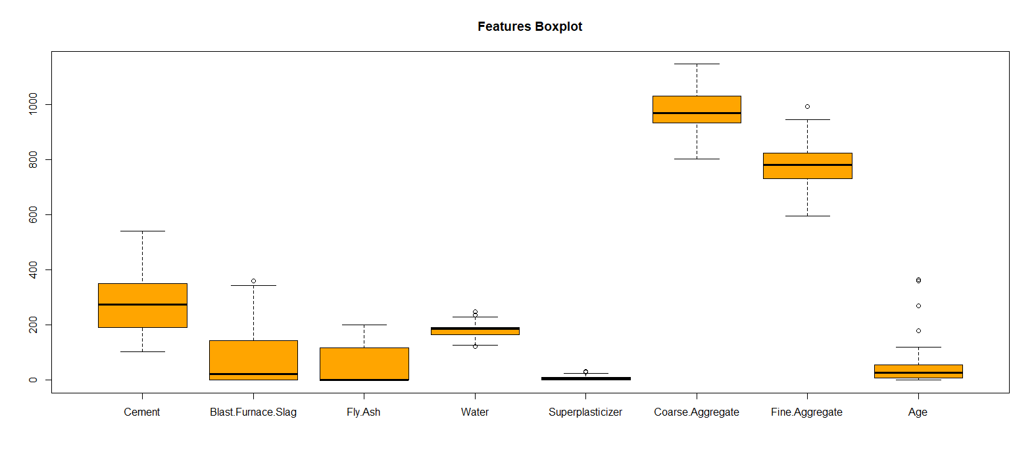
Box plot

Slide 9
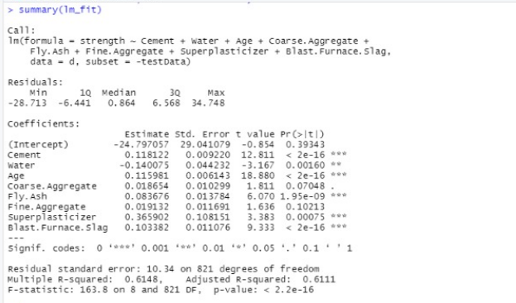
1st model

Slide 10

Correlation between original and prediction values for model 1

Slide 11
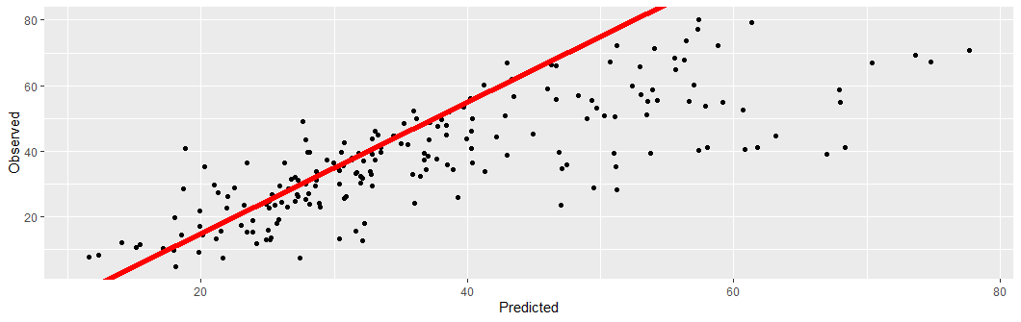

Slide 12
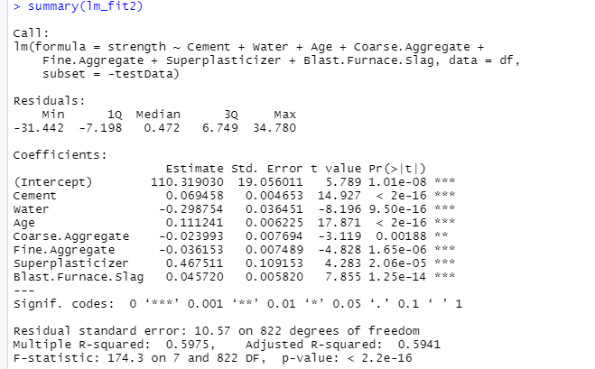
2nd model

Slide 13

Correlation between original and prediction value for model 2

Slide 14
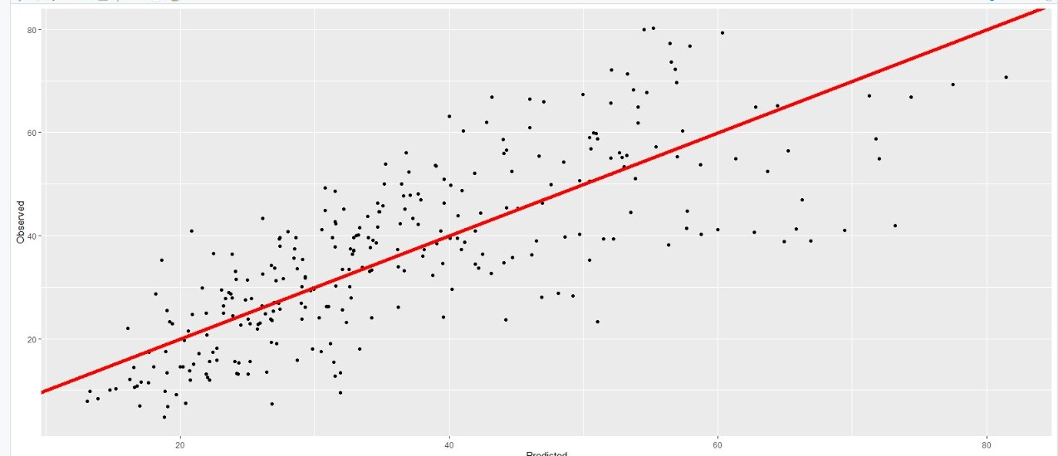

Slide 15
Conclusion
Model 1
Model 2
mean square error | 113.6798
correlation | 0.7815495
mean square error | 120.6842
correlation | 0.7677824

Slide 16
THANK YOU

